Slide 1



TwoStep
Sign Up
Login
Dance through life with TwoStep.
Sign Up
Name
Wouldn’t life be so much easier if you always knew the next step?
Email
Password
Sign Up

Slide 2

TwoStep
Hi Omri, Welcome to TwoStep!
TwoStep works best if you tell us a few things about yourself.
Connect to Facebook
We highly recommend connecting to Facebook – TwoStep can do a much better job for you. We import contacts,
your location, and your family information, and we will NEVER post to Facebook unless you explicitly tell us to.
Birthday
We use this to help select the most relevant Activities for you
Gender
We use this to customize the experience for you
Mobile number
We use this to send you reminders via text message, if you ‘d like
Next

Slide 3
TwoStep
Hi Omri, Welcome to TwoStep!
Next, please tell us a few things about your family.
Connect to Facebook
We highly recommend connecting to Facebook – TwoStep can do a much better job for you. We import contacts,
your location, and your family information, and we will NEVER post to Facebook unless you explicitly tell us to.
Spouse’s Name
We use this to help you stay on top of things that married people do
Spouse’s Birthday
We use this to help you stay on top of your spouse’s birthday
Spouse’s Gender
We use this to customize the experience for your spouse
Next

Slide 4
TwoStep
Hi Omri, Welcome to TwoStep!
Next, please tell us a few things about your family.
Connect to Facebook
We highly recommend connecting to Facebook – TwoStep can do a much better job for you. We import contacts,
your location, and your family information, and we will NEVER post to Facebook unless you explicitly tell us to.
Kid’s Name
We use this to help you stay on top of kid’s activities
Kid’s Birthday
We use this to help you stay on top of your kid’s birthday
Kid’s Gender
We use this to customize the experience for your kids
Another Kid
Done

Slide 5
TwoStep
Hi Omri, Welcome to TwoStep!
Next, please tell us about your home.
We highly recommend connecting to Facebook – TwoStep can do a much better job for you. We import contacts,
your location, and your family information, and we will NEVER post to Facebook unless you explicitly tell us to.
Address
We use this to help you stay on top of your home activities
Own?
We use this to help choose the most appropriate activities
Yard?
We use this to help choose the most appropriate activities
Another House
Done

Slide 6
TwoStep
Hi Omri, Welcome to TwoStep!
Next, please tell us about your car.
We highly recommend connecting to Facebook – TwoStep can do a much better job for you. We import contacts,
your location, and your family information, and we will NEVER post to Facebook unless you explicitly tell us to.
Name/Model
We use this to help you stay on top of activities relating to your car
Year
We use this to help choose the most appropriate activities
Another Car
Done

Slide 7
TwoStep
Hi Omri, Welcome to TwoStep!
Finally, connect TwoStep to your digital tools.
Connect to Facebook
We highly recommend connecting to Facebook – TwoStep can do a much better job for you. We import contacts,
your location, and your family information, and we will NEVER post to Facebook unless you explicitly tell us to.
Connect to Google Calendar
We highly recommend connecting to your Calendar – instead of having to install another app on your phone, TwoStep
seamlessly integrates with your Calendar to help you stay on top of the activities in your life.
Done

Slide 8
TwoStep
Hi Omri, Welcome to TwoStep!
Finally, connect TwoStep to your digital tools.
Connect to Facebook
We highly recommend connecting to Facebook – TwoStep can do a much better job for you. We import contacts,
your location, and your family information, and we will NEVER post to Facebook unless you explicitly tell us to.
Connect to Google Calendar
We highly recommend connecting to your Calendar – instead of having to install another app on your phone, TwoStep
seamlessly integrates with your Calendar to help you stay on top of the activities in your life.
Done

Slide 9
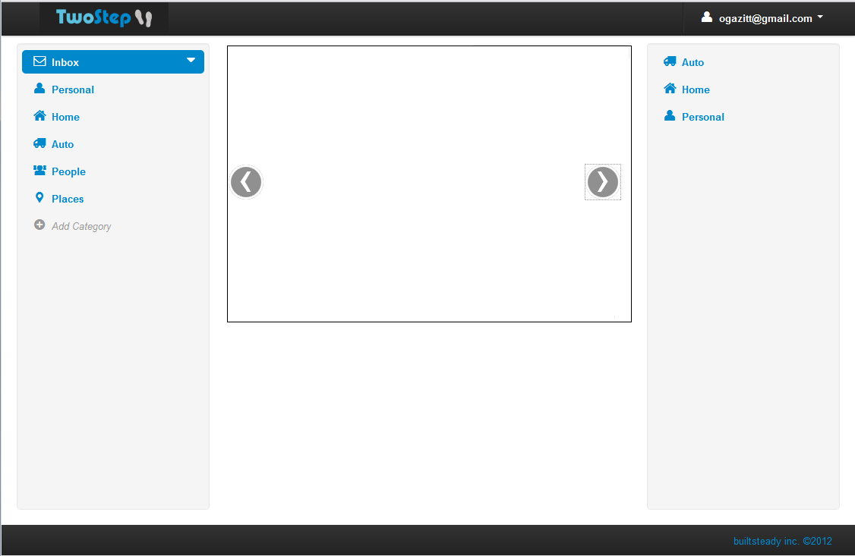
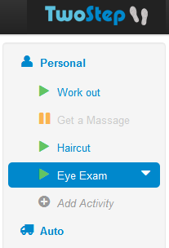
Hi Omri, Welcome to TwoStep!
Here’s a short introduction to the product.
TwoStep has two main views – the Dashboard (currently displayed), and the Next Steps view.
In the Dashboard, the pane on the left is called the Organizer. The Organizer contains Categories (e.g. Personal, Home), and each Category contains Activities. Click a Category to view and select the Activities inside.

Slide 10
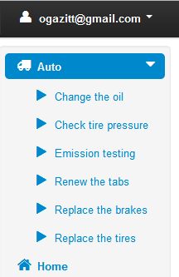
Hi Omri, Welcome to TwoStep!
Here’s a short introduction to the product.
The pane on the right side of the dashboard is the Gallery. You can click on the arrow on an Activity or Category to select the Install action, which will add that Activity or that entire Category of Activities to your Organizer.

Slide 11
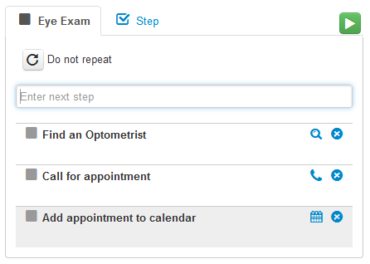
Hi Omri, Welcome to TwoStep!
Here’s a short introduction to the product.
The middle pane of the Dashboard allows you to edit the selected Activity. You can add, remove, or reorder Steps, and control how the Activity repeats.
When you are satisfied with the Activity, click the green Run icon on the top-right corner to run the Activity. To edit the Activity again, click the Pause icon.

Slide 12
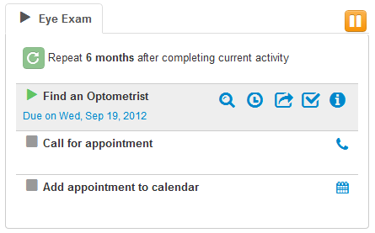
Hi Omri, Welcome to TwoStep!
Here’s a short introduction to the product.
In Run mode, the current Step is shown, and you can Defer, Skip, or Complete the Step.
In addition, TwoStep recognizes a number of Smart Steps (Find, Call, Add to Calendar, etc) which can also be changed explicitly by selecting the Step type. Each Smart Step has its own Action icon that can help you carry out that Step.

Slide 13
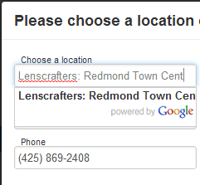
Hi Omri, Welcome to TwoStep!
Here’s a short introduction to the product.
If a Smart Step requires more information (for example, a Call Step needs a phone number), a dialog box will prompt for a location or contact and try to obtain the phone number automatically.
Smart Steps work better when TwoStep is connected to Facebook and Google: Contacts are auto-completed from Facebook, and the “Add to Calendar” Smart Step only works if you connected to Google.

Slide 14
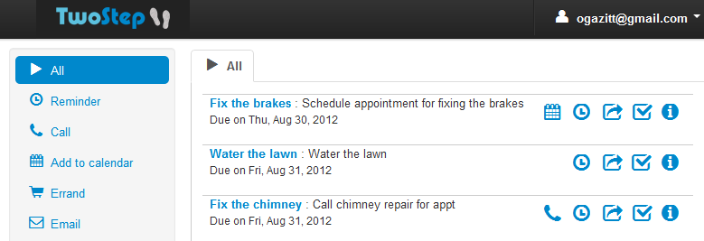
Hi Omri, Welcome to TwoStep!
Here’s a short introduction to the product.
TwoStep’s other main view is the Next Steps view. This view presents all your immediate next steps across all Activities, sorted by due date. It also allows filtering the Steps by Step Type (all phone calls), and carrying out the Step by clicking its Action icon.

Slide 15
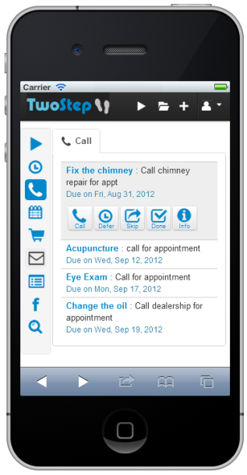
Hi Omri, Welcome to TwoStep!
Here’s a short introduction to the product.
Finally, TwoStep’s Mobile app is accessible on the go from any mobile device (iPhone, iPad, Android, Windows Phone and any other device with a browser) by navigating to the TwoStep website.
The Mobile app allows you to complete Steps on the go (Call, Schedule, Map) as well as viewing your running Activities and adding new Activities to your Inbox.

Slide 16
Hi Omri, Welcome to TwoStep!
Here’s a short introduction to the product.
That’s it! While there are more features we can tell you about, you now know enough to get started. We hope you enjoy using TwoStep and find it as useful for managing your life as we do.
So check out your Organizer, select some Activities and run them, and let TwoStep help you stay on top of things!

